Slide 1

Smart Voice Assistant
1.Gaurav Sharma(Reg No:23BEE1100)

Slide 2

Contents:
Introduction
Objective
Methodology
Experiment Setup
Block Diagram
Components Purchased
Expected Outcomes
Summary

Slide 3
Objectives
Thus, create a voice assistant capable of conversing with user(using text to speech and speech to text model).
Create a device using nodeMCU32 capable of converting given audio input to text
Create a smart device capable of conversing with user and giving text replies.
Interface the above two devices and converting the text output generated by second device to audio output.

Slide 4

Give wakeup call to our device.
Give audio input to our device.
Get the answer from our device as text.
Convert this text output to speech via speaker, which is then heard through speaker.
Thus effectively creating a voice assistant capable of conversing with user.

Slide 5
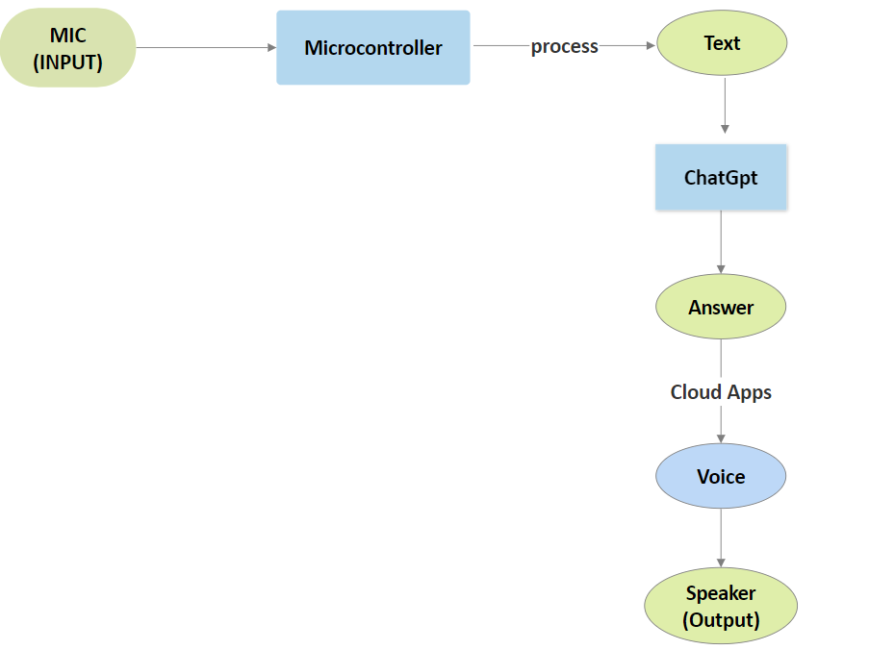
Experiment Setup

Slide 6
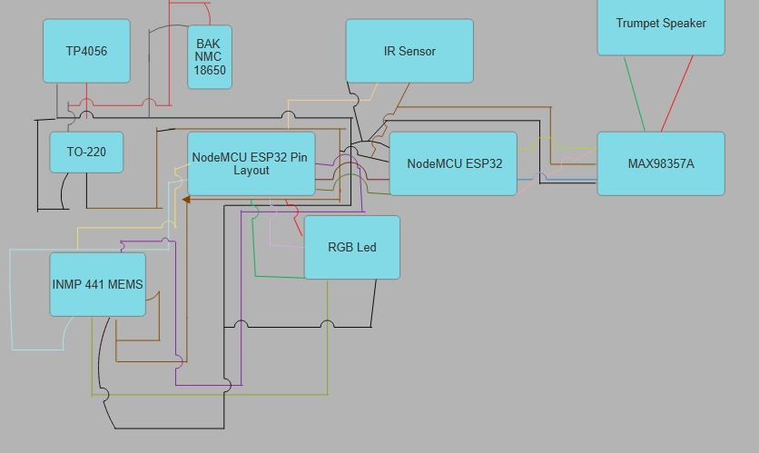
Block Diagram

Slide 7
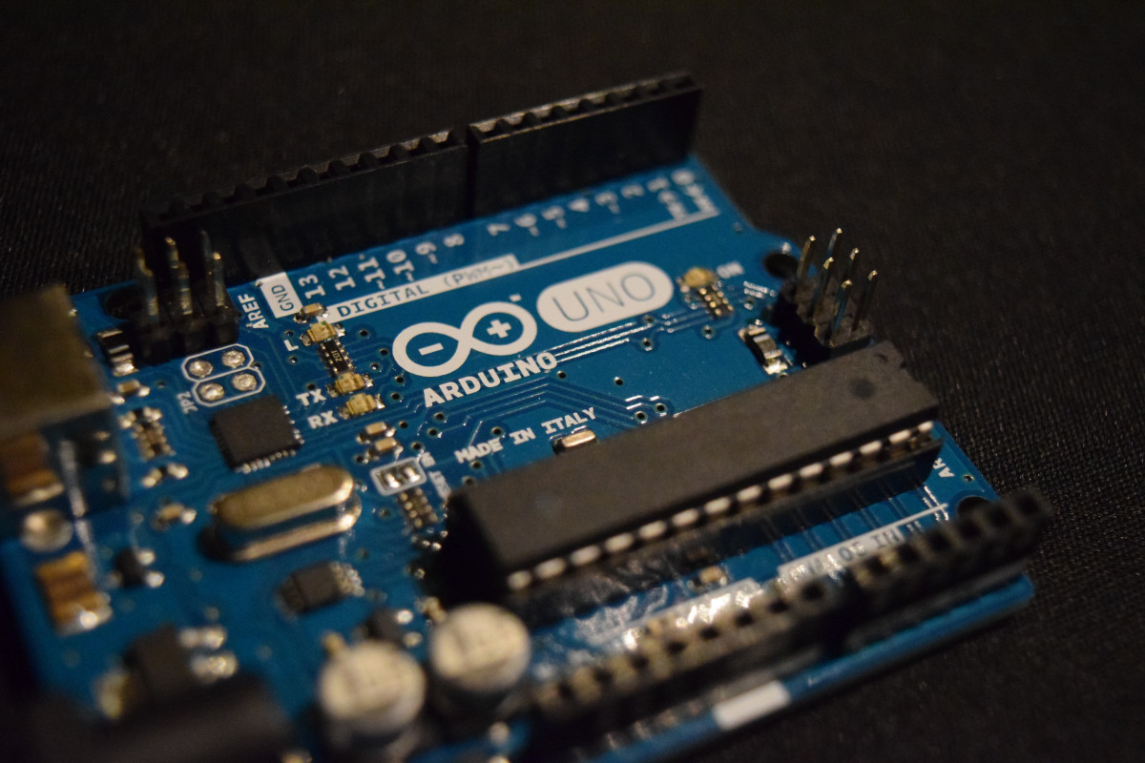
Components Purchased
Two NodeMCU32(Micro-Controller)
Microphone Module(INMP44S)
Audio Amplifier(MAX98357a)
Battery(BAK NMC 18650)
Battery Charging module(TP4056)
Volage Regulator(LM317T)
Speaker(0.5W 80HM Trumpet Speaker)
IR sensor and RGB led.

Slide 8
Expected Outcome
Speech-To-Text:
Create a device capable of getting audio input from user and converting it to text.
Connect to internet(and ChatGPT):
Make a device capable of wireless connection to internet so that it can access ChatGPT to generate responses to questions asked as text.
Text-To-Speech:
Make it so that the second device capable of converting given text reply from ChatGPT to audio output.
Interfacing Of Devices:
Interfacing the above devices so that we are able to realize a fully functional voice assistant able to hold real time conversations.

Slide 9
Summary:
We have created a device capable of converting voice input to text(Speech-To-Text).
We have created a second device that can connect to the internet wirelessly and get replies from ChatGPT for questions asked as text.
The second device in addition to wireless connection to the internet also converts text to audio output, that can be heard via speakers(Text-To-Speech).
We interfaced these two devices and hence realized a fully functional voice assistant capable of holding real time conversation.

Slide 10
Thank you

